Slide 1


Video Games Analytics
Dylan, Sarah, & Lizzy
Team High Five

Slide 2

Introduction
This dataset is all about the Video Games that were released from 2004-2008.
The data features lots of information from the title of every game to the average playtime of each title.
The data is from CORGIS, and was Originally collected by Dr. Joe Cox at University of Portsmouth.

Slide 3


.
Data Visualization
The CORGIS version was cleaned
We had to rename most columns for SQL
We had to delete lots of extra/incomplete data
The dataset ended up with half of the original columns

Slide 4
Research Questions
1. What game takes the longest to play through? Monster Hunter Freedom
2. How many games did Sony release in 06? 14
3. How many Call of Duty titles were released in the time frame? 6
4. How many games were rated E, M, or T in the time frame? E = 491, M =251, T =470
5. Which console has the most games based on the dataset? Nintendo DS
Notes:
What game takes the longest to play through? Monster Hunter Freedom
How many games did Sony release in 06? About 17
How many Call of Duty’s were released in the time frame? 6
How many games were rated E, M, or T in the time frame? E = 491, M = 251, T = 470
Which console has the most games based on the dataset? Nintendo DS

Slide 5
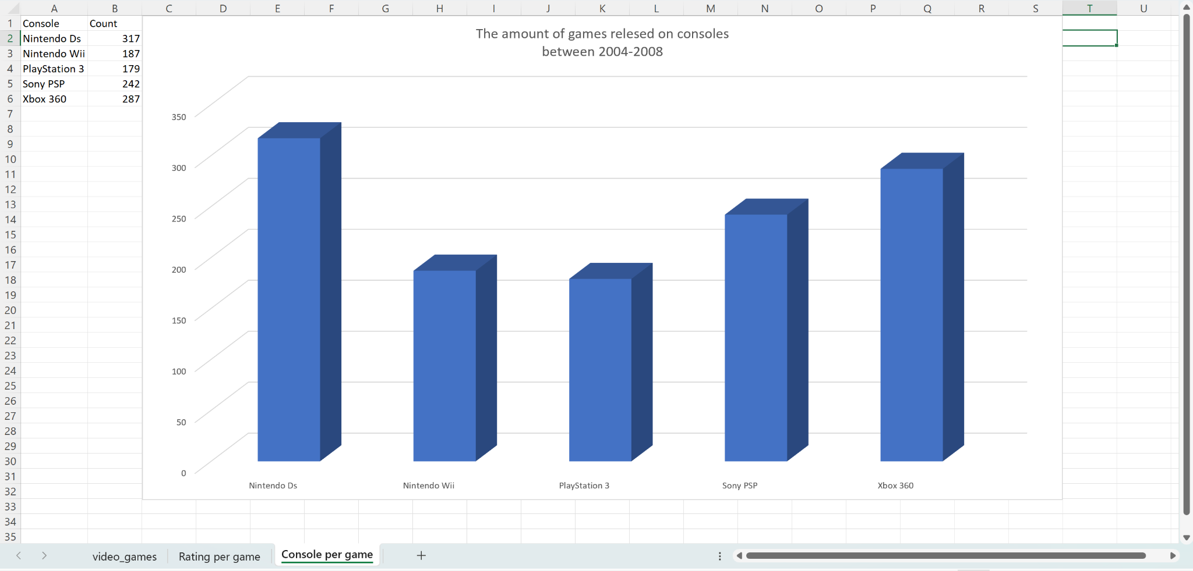
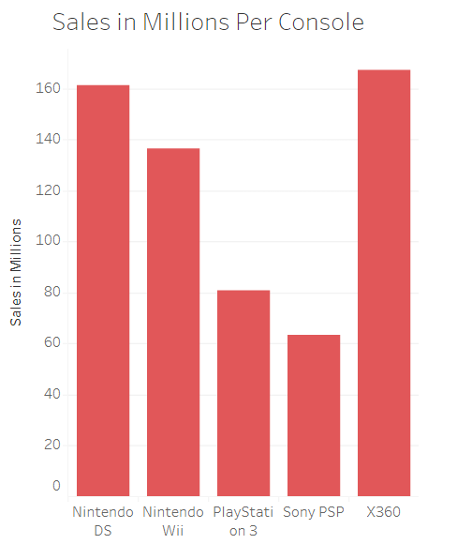
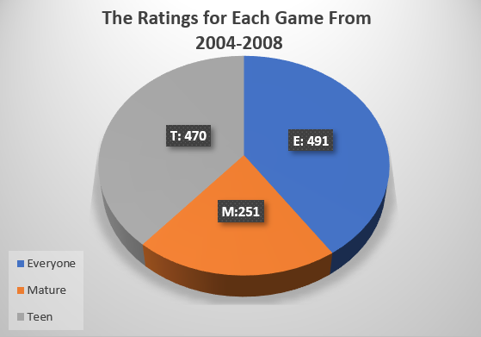
Data Visualizations

Slide 6
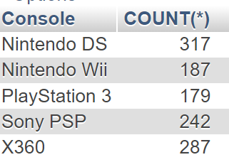
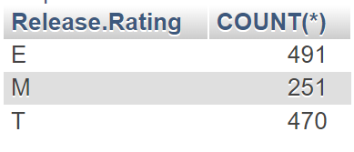
SQL Queries and Results
SELECT `Console`,
COUNT(*)
FROM `Video Games`
Group BY `Console`
SELECT `Release.Rating`,
COUNT(*)
FROM `Video Games`
Group BY `Release.Rating`
Which console has the most games based on the dataset?
How many games were rated E, M, or T ?

Slide 7

.
Conclusion
What we learned:
Not all data in a dataset is useful data.
how much Nintendo was dominating the video
game space in 2004-2008.
Challenges:
Trying to read our data. We overcome that by data cleaning.
Trying to get questions to work for our data. We
overcome this by making better
understanding questions.
What we would do next time:
We would grab data that is more
relevant and make this dataset more modern.
A question we could not Answer:
The amount of genres, due to them being mixed together.

